Slide 1
A New Approach to Market Liquidity Risk
London, 13 May 2010

Slide 2
AGENDA
About StatPro
Market Liquidity Risk
The StatPro Approach

Slide 3
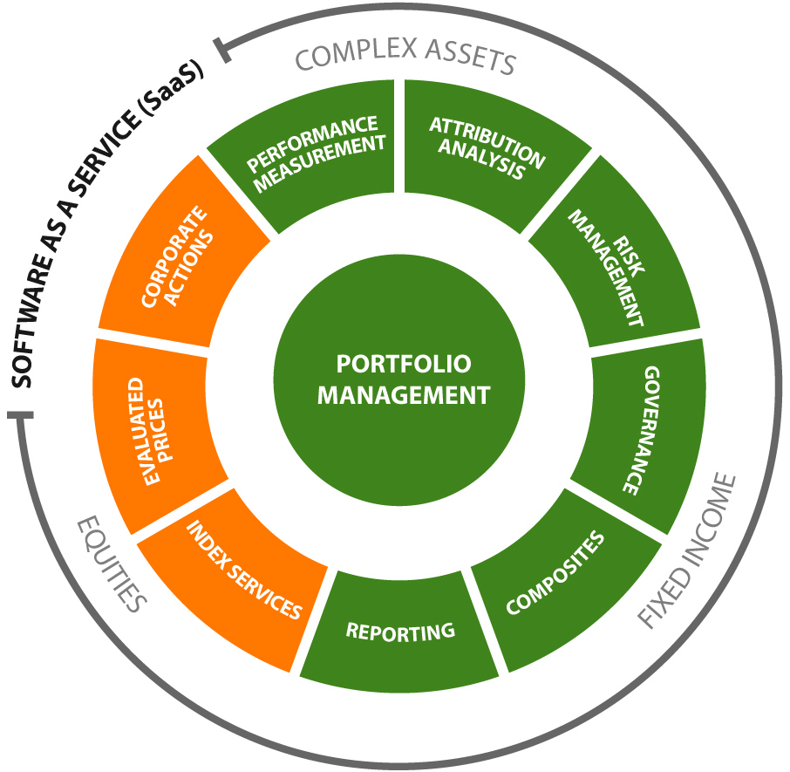
Introduction
StatPro is a Provider of Portfolio Analytic Solutions and Data for the Global Investment Management Industry

Slide 4
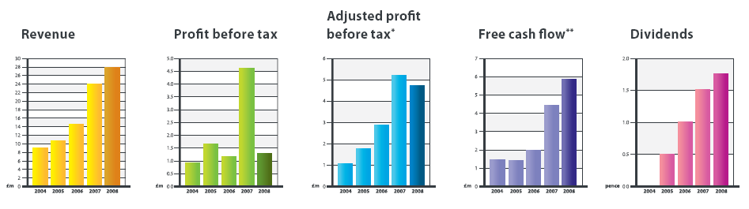
StatPro Group
  Established – 1994
  Publicly traded
  Clients: 220+
  Clients include 13 of the 20 largest global Asset Managers
  Clients include 7 of the 10 largest global Custodians
  Investment in R&D – Over 90 staff in development
  Over 95% Client retention
  SAS70 and ISO27001 Compliant

Slide 5

Global Office Locations

Slide 6
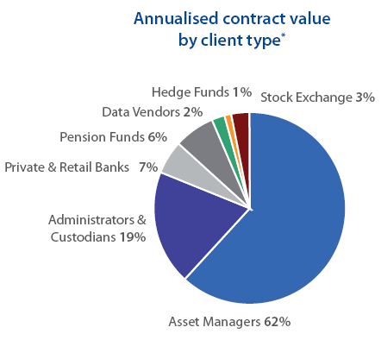
Client Profile
StatPro is a one stop shop for analytics and data. Our products & services are marketed to:
  Asset Managers
  Custodians
  Pension Funds
  Insurance Companies
  Private and Retail Banks
  Others (Ucits III ManCos, Consultants...)

Slide 7

















Global client base

Slide 8
Client oriented strategy
  Cost reduction
  Hosted Services
  Integration of all modules within a single platform
  Security Management
  Vertical Integration
  Data & Analytics
  - Risk Data Management Service
  - Index Service
  - Fixed Income Greeks Delivery Service
  - CAF for Buy & Hold models
  Evaluated Pricing and Data Service
  - Plain vanilla securities, Bond OTC, OTC Derivatives

Slide 9
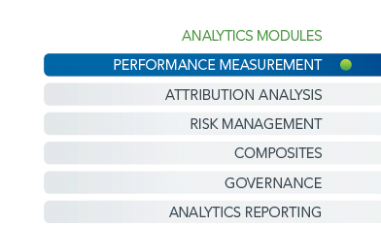
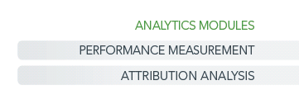
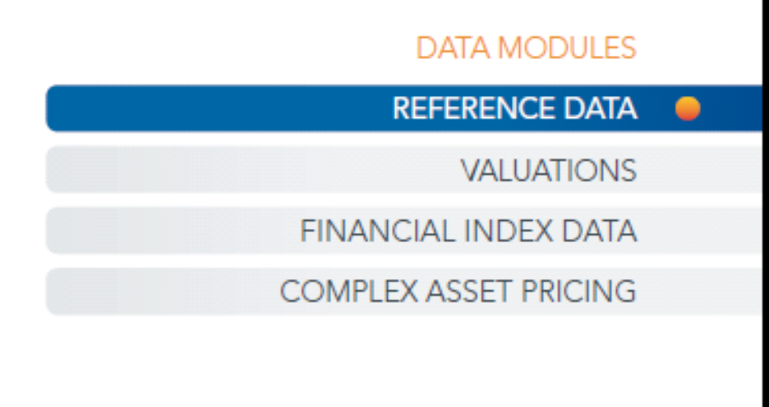
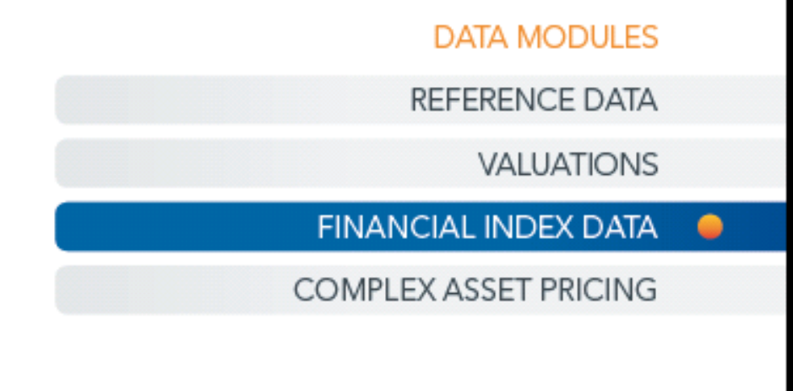
Product overview

Slide 10
AGENDA
About StatPro
Market Liquidity Risk
The StatPro Approach

Slide 11
Definition of Market Liquidity Risk
“Risk of realizing a lower value than market value when liquidating one or more assets in a portfolio”
Market Liquidity Risk is different from Funding Liquidity Risk
Market Liquidity Risk measures the potential portfolio loss in case of sudden liquidation

Slide 12
Traditional Approach
Bid/Ask: sell long position at bid, buy short positions at ask
Volumes: monetary value of the position divided by average daily volume equals no. of days needed to liquidate the position

Slide 13
New Approaches
More sophisticated approaches are being produced
Acerbi-Scandolo - “Liquidity Risk Theory and Coherent Measures of Risk” - 2007

Slide 14
The Liquidity Paradox
The Liquidity Risk Paradox: data needed for model calibration (e.g. bid/asks, book, volumes) is available if a product trades and is liquid.
Both approaches ignore assets for which there is no information available (e.g. illiquid bonds)
No coverage for the worst problems of liquidity risk!

Slide 15
Other Problems in Volume-Based Approaches
Even for simple equities the proliferation of markets makes it hard to have the real daily volume
Hard to have a reliable bond volume as OTC market remain dominant
Both in bonds and in equities you can get a quote from a market-maker for volumes higher than daily volumes

Slide 16
AGENDA
About StatPro
Market Liquidity Risk
The StatPro Approach

Slide 17
The StatPro Approach: Objectives
Universal Approach for any asset class/any instrument
Empower the risk manager to spot critical situations across multiple portfolios/multiple asset classes/hundreds of thousands assets …
… by controlling a limited number of parameters

Slide 18
StatPro Approach: The Components
Component 1: How does a market maker build a price in absence of observable and tradable bid & asks?
Component 2: Specific Liquidity Haircut by Asset Class/Pricing Function
Component 3 (bonds only): Liquidity Haircut by Issued Nominal
Component 4 (equity only): Liquidity Haircut by Market Caps
Component 5 (equity only): Liquidity Haircut by % of Ownership

Slide 19
StatPro Approach: Scenario Based
We provide 3 “standard” scenarios:
    Normal Market Conditions
    Stressed Conditions
    Highly Stressed Conditions
Under each scenario we calibrate one set of central parameters for each of the 5 components
Clients can create their own scenarios

Slide 20
Component 1: Bid/Ask of Risk Factors
When a bond, a certificate, an option ,a hybrid equity instrument (i.e. convertible or capital-protected equity linked), etc. is not traded, how does a market maker create a bid and a ask price?
Selects the relevant pricing function for the instrument
Observes the risk factors that, introduced in the pricing function, will generate a fair price (i.e. an IRS curve, CDS quotes, implied vols, etc.)
Introduces in the pricing function the bid or the ask of the relevant risk factor, depending on the exposure of the instrument to that risk factor
Computes the instrument fair bid and fair ask
If one of his quotes is hit he will hedge risk exposures in the underlying derivatives market
Rationale: derivatives markets are normally more liquid than cash markets. E.g. fixed income derivatives have been far more liquid than bond markets during the last crisis

Slide 21
Component 1: The Process
The Link Between An Asset and Its Risk Factors: The Pricing Function
  Px = f (Rf1, Rf2, …Rfn)
Shock Risk Factors By Bid/Ask Spread
Rfi* = Rfi +/- Δi / 2
Δi = Bid/Ask Spread of i-th Risk factor
Compute Shocked Asset Price and Liquidity Haircut
Px* = f (Rf1*, Rf2*, …Rfn*)
Liquidity Haircut = Px* - Px with Px* < Px

Slide 22
Component 1: Scenario Analysis
The process of component 1 is very similar to a traditional stress test/what-if scenario analysis
The difference is that Liquidity Scenarios recognize the sensitivity of the price to each risk factor and apply either the bid or the ask of the risk factor
Stress Scenarios can instead shock one risk factor only in one direction
Imagine the sensitivity to implied vol of a convertible and reverse convertible bond issued on the same underlying equity

Slide 23
The Other Components
Component 2: association of one additional liquidity haircut per pricing functions. Concept: haircut=0 for fixed rate coupon bond, higher than zero for a convertible bond, quite high for an ABS
Component 3: definition of a grid of Outstanding Nominal buckets, each associated with one liquidity haircut. Concept: a 50m $ issue will be less liquid than a 5b $ issue
Component 4: definition of a grid of Market Cap buckets, each associated with one liquidity haircut. Concept: a small cap has a higher bid/ask spread than a big cap
Component 5: definition of a grid of “% of Ownership’ buckets. % of Ownership says how much of the market cap of a stock I am holding in the aggregate under analysis. Each bucket is associated with a liquidity haircut

Slide 24
Thank You for Your Attention
Dario.Cintioli@statpro.com

